Slide 1
Image Segmentation using Euler Graphs
Sneha.D.L(12MCS1037)

Slide 2
Overview
Image Segmentation
Applications
Euler graphs
Euler theorem
Methodology
Experimental Results
Conclusion

Slide 3
Image Segmentation
In computer vision segmentation is the process of partitioning a digital image into multiple segments (sets of pixels also known as superpixels).
The goal of segmentation is to simplify and/or change the representation of an image into something that is more meaningful and easier to analyze.
Image segmentation is typically used to locate objects and boundaries (lines, curves, etc.) in images.
More precisely, image segmentation is the process of assigning a label to every pixel in an image such that pixels with the same label share certain visual characteristics.

Slide 4
Image Segmentation Applications
Medical imaging
Locate tumors and other pathologies
Measure tissue volumes
Computer-guided surgery
Diagnosis
Treatment planning
Study of anatomical structure
Locate objects in satellite images (roads, forests, etc.)
Face recognition
Iris recognition
Fingerprint recognition
Traffic control systems
Brake light detection
Machine vision
Agricultural imaging – crop disease detection

Slide 5
Euler graphs
Let G(V,E) be the given graph with V and E representing the vertex set and edge set respectively.
Definition 1. A trail that traverses every edge of G is called an Euler trail. It is named as Euler trail because Euler was the first to investigate the existence of such trails in graphs.
Definition 2. An Euler tour is a tour which covers all the edges of G.
Definition 3. A graph is an Euler graph or Eulerian if it contains an Euler tour.

Slide 6
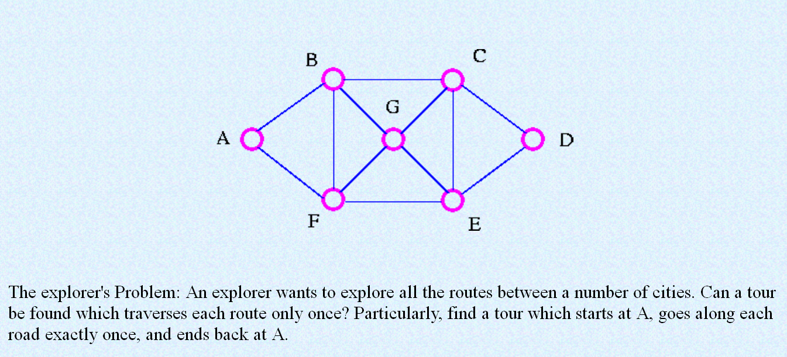

Slide 7
A B C D E F B G C E G F A A F G C D E G B C E F B A

Slide 8
Euler theorem
Euler proved the following theorem and corollary through which a graph has Euler tour can be determined. The following characterizations are taken as they are defined and proved in Bondy and Murty (1982).
Theorem 4. A non-empty connected graph is Eulerian if and only if it has no vertices of odd degree.
Corollary: A connected graph has an Euler trail if and only if it has at most two vertices of odd degree.

Slide 9
Methodology
Proposed Method
The Euler graph and its properties are exposed in this work for solving image segmentation problem.
The basic idea is that Euler graph is decomposed into edge disjoint cycles. The steps of the proposed method are given below:
Step-1: Representation of image as a grid graph
Step-2: Conversion of grid graph into Eulerian
Step-3: Segmentation Procedure
Step-4: Refinement of segments

Slide 10
Representation of image as a grid graph
The image to be segmented is represented as a graph G(V,E).
To do so, each pixel is treated as a vertex of the graph.
Edges are defined based on 8–connectivity of the neighborhood vertices.
An edge (vi,vj) 2 E corresponds to a pair of neighboring vertices.
The graph G, thus obtained is an undirected weighted non-planar graph.
Clearly, an image of size N ×N contains N2 vertices, (N −1)N vertical edges, N(N −1) horizontal edges and 2(N −1)2 diagonal edges. Thus, in total there are (N −1)N +N(N−1)+2(N−1)2= 4N2−6N+2 edges.
Let M = 4N2−6N+2. The graph thus formed is visualized as a grid and hence called as grid graph.
The weights are assigned to the edges by using the absolute intensity difference between the adjacent pixels.

Slide 11
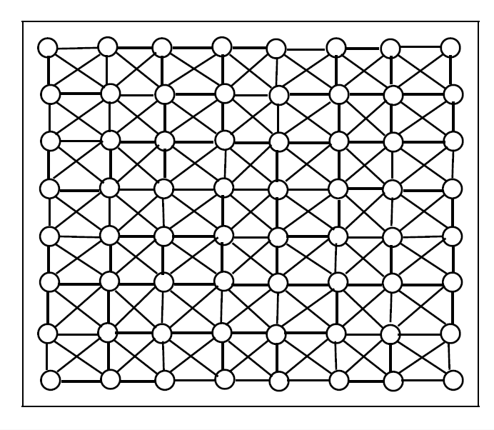
A sample grid graph of size 8×8

Slide 12
Conversion of grid graph into Eulerian
The grid graph thus obtained is a connected non-Eulerian because some of the vertices have odd degree.
The procedure for the conversion to Eulerian guarantees the formation of cycles covering all edges since all the vertices are of even degree.
Border vertices are the vertices on the first row, last row, first column and last column. For this reason, the grid graph can be converted to Eulerian so that all vertices have even degree.
This can be achieved in two ways.
In the first case i.e., by adding one extra multiple edge for each of disjoint pair of adjacent odd degree vertices.
The same weight is allocated to both duplicated and original edge to avoid ambiguity.
The process is repeated until no such pair exists.

Slide 13
Conversion of grid graph into Eulerian
In the second case, instead of adding duplicate edges to the pair of adjacent vertices of odd degree,
alternate edges are removed at the boundary to maintain even degree. It is found that there is no loss of information from images by removing such edges because all the edges removed are due to border vertices.
In practice, there is not much information available at the border vertices and experimentally it is found that there is no variation in the segments formed in either way.

Slide 14
Segmentation Procedure
The algorithm uses a color structure which labels the edges as given below:
• Initially all edges are in WHITE color
• A visited edges is in GRAY color
• An edge in BLACK color indicates that it is a part of the boundary of a region.

Slide 15
Refinement of segments
At this stage, all the edges are labeled to either gray or black.
Refinement of black colored edges is not possible because they represent the boundaries of the regions already formed.
The gray colored edges are subjected for refinement. The same procedure is used to form regions by choosing any randomly selected gray colored edge and for further traversals.
In this way, the algorithm tries to refine the segmentation for regions formation. Too much of refinement leads to over segmentation and no refinement leads to under segmentation.
A moderate level of refinement is necessary.

Slide 16
Experimental Results
The proposed method is tested on standard Berkeley Image database. Two trivial synthetic images
have been created and tested the algorithm on them. The results of the two synthetic images and the cor-
responding results are shown in Figure 3. The results presented in Figure 3 are the induced segmentations
obtained before refinement process.
Figure 3: Segmentation results-I of synthetic images
In Figure 3, (a) and (c) are the two synthetic images created and the corresponding segmentations
are shown in (b) and (d). These two synthetic images are created in such a way to study the behavior of
the algorithm in open_paths case. As mentioned in the algorithm, the temporary_growing_vector stops
traversing when there is no suitable edge satisfying the criteria. In such case the path is not closed and
hence it is stored in open_paths vector. In Figure 3b, the segmentation result shows two open_paths

Slide 17
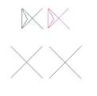
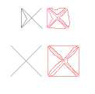
There are 4 closed regions.
The refinement process, in these cases, tried to get closed regions and in that process lead to over segmentation.

Slide 18
This may be true in real images also.
The results of some real images taken from Berkeley Image database are shown in nxt Figure.
The first and third columns represent the original image and second and fourth columns represent the segmentation result obtained.

Slide 19
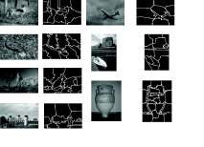
Segmntation on Berkeley Image database

Slide 20
Conclusion
In this paper, a novel algorithm for segmenting an image into different regions using Euler graphs has been proposed.
The algorithm starts by randomly choosing an edge and tries to form closed regions.
In cases, open paths are formed. The color look up table is used for edges to trace their transition.
A white color indicates unvisited edge, a gray color indicates visited and may go for refinement and black color indicates visited and marked permanently for no refinement since it is already a part of a region boundary.
The procedures discussed run in polynomial time.
The MST and cycles method performs better compared to Euler Graph method in terms of precision, recall and F measures.

Slide 21
Thank You

